Slide 1

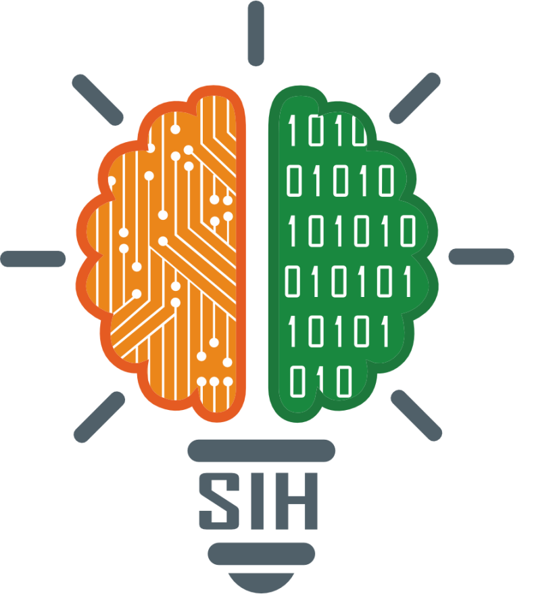
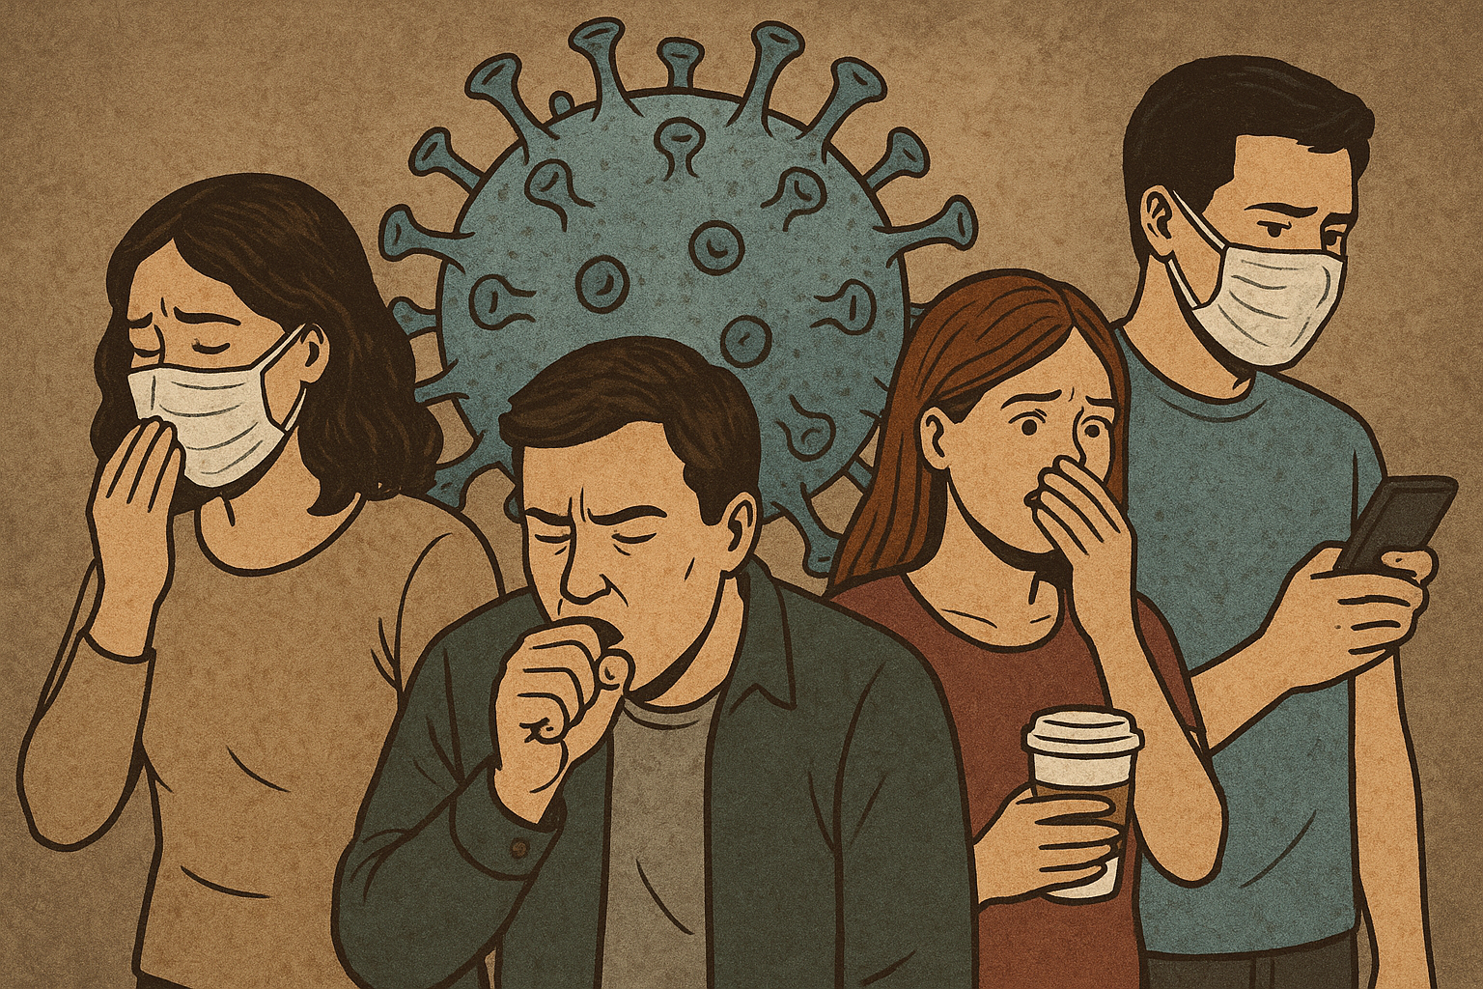
SMART INDIA HACKATHON 2025
Problem Statement ID – SIH25049
Problem Statement Title- AI-Driven Public Health Chatbot
For Disease Awareness
Theme- Healthcare – Improving Awareness, Accessibility,
and Preventive Care in Rural & Semi-Urban Communities
PS Category- Software
Team ID-
Team Name : League of coders

Slide 2
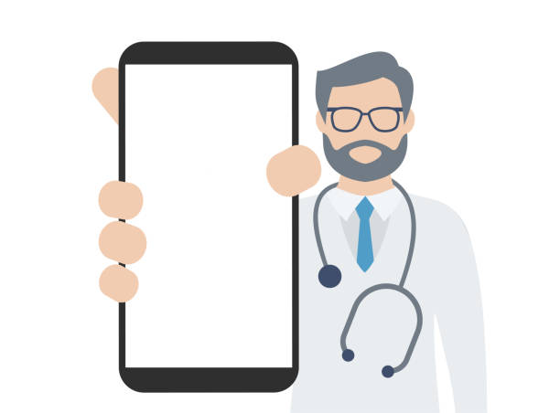
AI-Driven Public Health Chatbot for Disease Awareness
League of coders
Proposed Solution :
24/7 digital health assistant (text + voice).
Disease info, vaccination reminders, outbreak alerts.
NLP + Voice AI (STT & TTS) for natural conversations.
Integrates with govt. health databases.
Cloud-based for scalability & reliability.
Tackles misinformation & literacy barriers.
Improves vaccination adherence & awareness.
Provides timely outbreak alerts.
Voice-enabled, multilingual & device-friendly.
Real-time integration with govt. services.

Slide 3
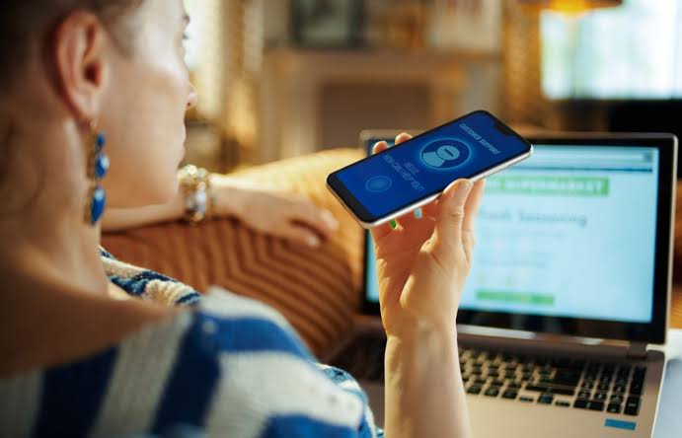
TECHNICAL APPROACH
League of coders
Methodology / Process:
User speaks or types a query (WhatsApp, SMS, or voice input).
Voice input is converted into text using speech-to-text AI.
NLP engine processes input (intent detection & response generation).
System fetches relevant info from health databases & outbreak APIs.
Provides reminders (vaccinations, checkups) & emergency alerts in both text and speech.
Technologies to be used:
Programming: Python, JavaScript
Frameworks: Rasa/Dialogflow (NLP), Flask/Django
Voice AI: Google Cloud Speech-to-Text, Amazon Polly, Azure Speech Services
Cloud: AWS/Azure/GCP for scalability
Databases: Government health APIs, SQL/NoSQL storage

Slide 4
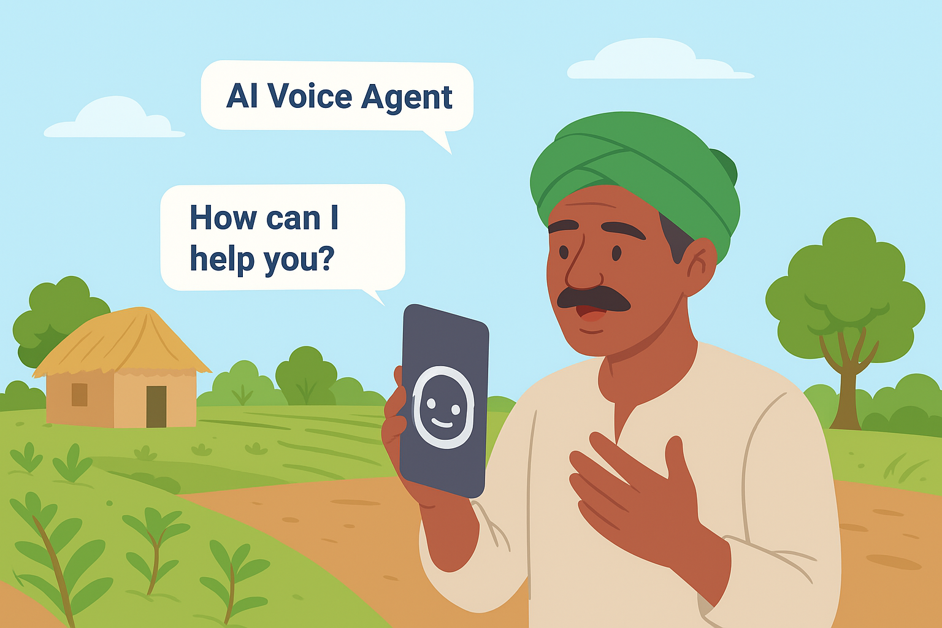
FEASIBILITY AND VIABILITY
League of coders
Voice AI (STT + TTS) is mature and easily integrable with NLP/chatbots.
Potential challenges:
Handling dialects and accent variations.
Maintaining accuracy in noisy environments.
Cost of cloud-based voice APIs.
Strategies to overcome:
Build region-specific voice datasets.
Offline caching for common responses.
Optimize API usage to reduce costs.

Slide 5
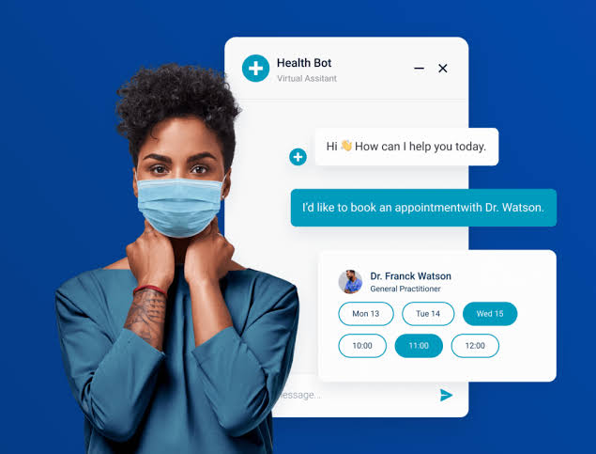
IMPACT AND BENEFITS
League
of
coders
Impact on target audience:
Rural and semi-urban populations with limited literacy and healthcare access.
Benefits:
Social: Removes literacy/language barriers, increases healthcare awareness.
Economic: Reduces unnecessary hospital visits, lowers costs.
Environmental: Digital-first approach, less paper-based awareness campaigns.
Government: Stronger citizen connection through voice + text AI health services.

Slide 6
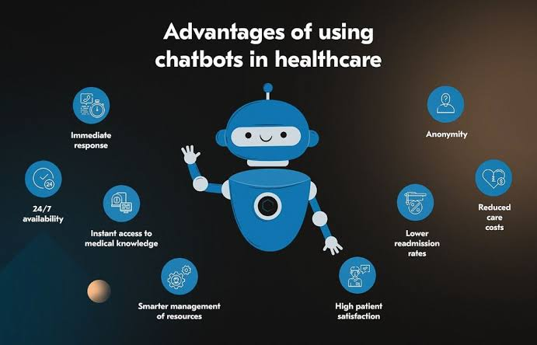
RESEARCH AND REFERENCES
League of coders
Florence Chatbot – used for medication & appointment tracking.
WHO & Government health portals for disease/vaccine data.
AI Voice Assistants (Google Speech-to-Text, Alexa, Azure TTS) used in healthcare for elderly and rural assistance.
Case studies of voice-enabled AI chatbots for healthcare accessibility.

Slide 7
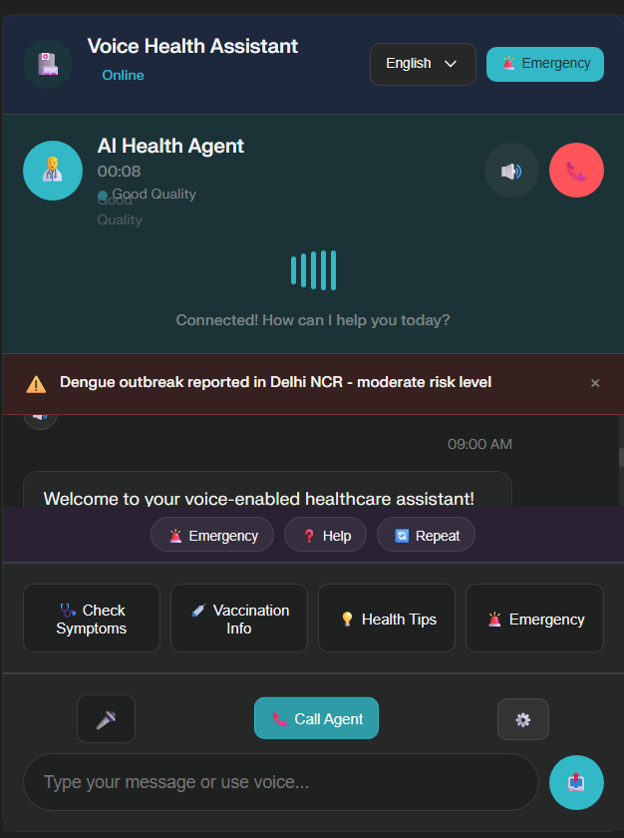
PROTOTYPE :
https://ppl-ai-code-interpreter-files.s3.amazonaws.com/web/direct-files/6740e33b6f24b98dcb235a36595f9f3b/37da8a8a-9183-47cb-83ee-3271d59deef5/index.html?utm_source=perplexity

